Slide 1
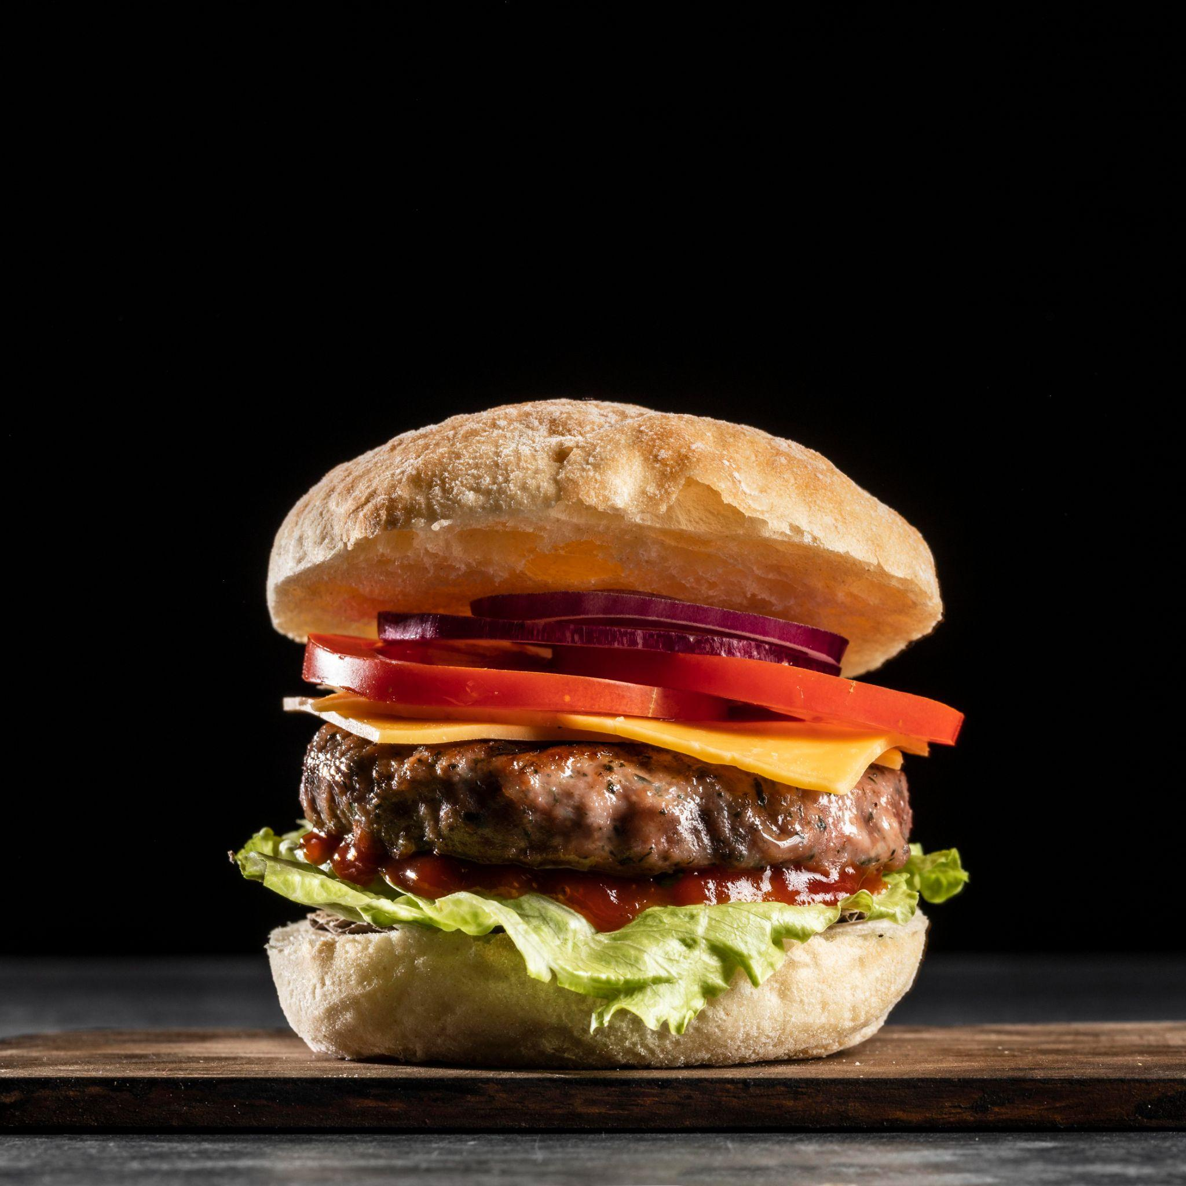
Online food ordering system
Programming final project.

Slide 2
Table of contents
01
02
03
Introduction
Project Structure
Conclusion

Slide 3


01
Introduction
What is our project?

Slide 4

Our project is:
Our project is about an online food ordering system. It allows users to browse through a menu of items, add their desired items to a virtual shopping cart, and manage their selections before finalizing their purchase. Test data

Slide 5
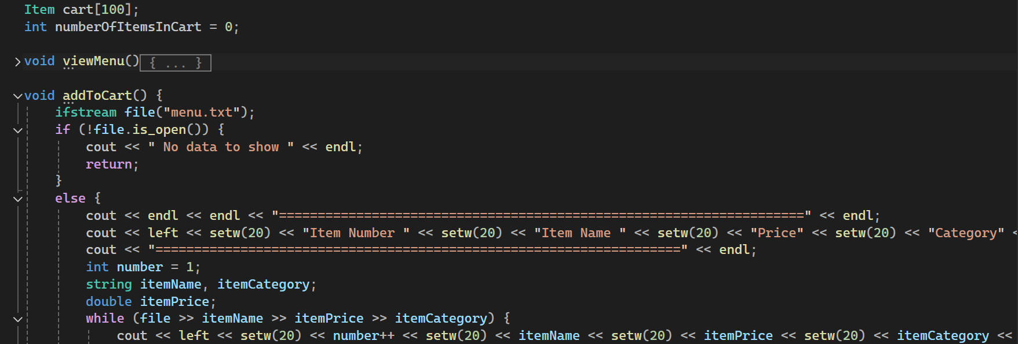
Project structure
02

Slide 6
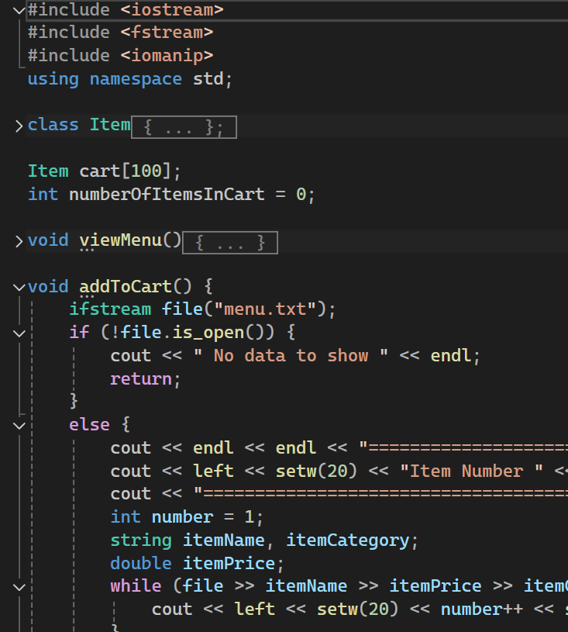
Project structure:
01 Headers
01 #include <iostream>: Provides functionalities for input and output.
02 #include <fstream>: Provides functionalities for file handling.
03 #include <iomanip>: Provides functionalities for manipulating the output format.

Slide 7
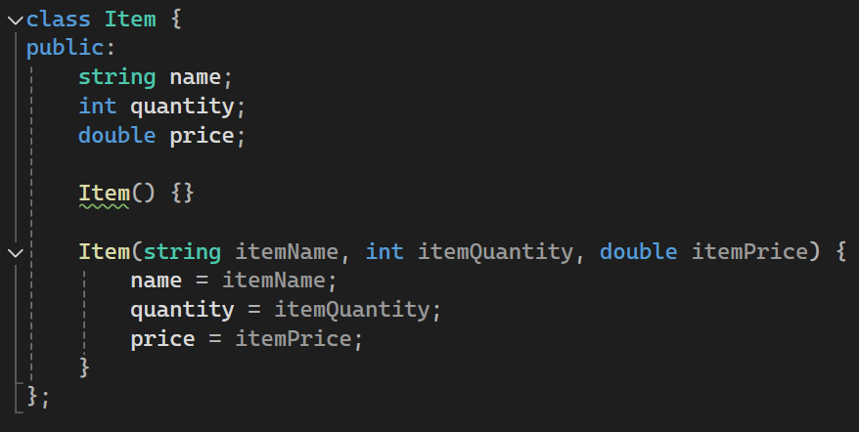
02 Item class
It represents an item with attributes such as name, quantity, and price.

Slide 8
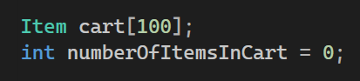
03 arrays
01 Cart is an array that stores up to 1oo item in the cart.
02 nameifitemsincart is an integer that keep tracking the number of items in cart

Slide 9
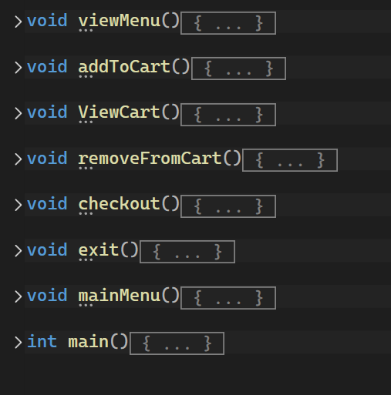
04 Functions:
01 menueDisplay
It displays the menu to the user based on the chosen category.

Slide 10
01 menueDisplay
Opening File: Opens the menu.txt file to read the menu items.
Checking File Status: If the file is not open, it displays a message "No data to show".
Displaying Categories: Prompts the user to select a category.
Reading and Displaying Items: Reads items from the file and displays them if they match the selected category using setw for formatting the output in columns.
Closing File: Closes the file after reading.

Slide 11
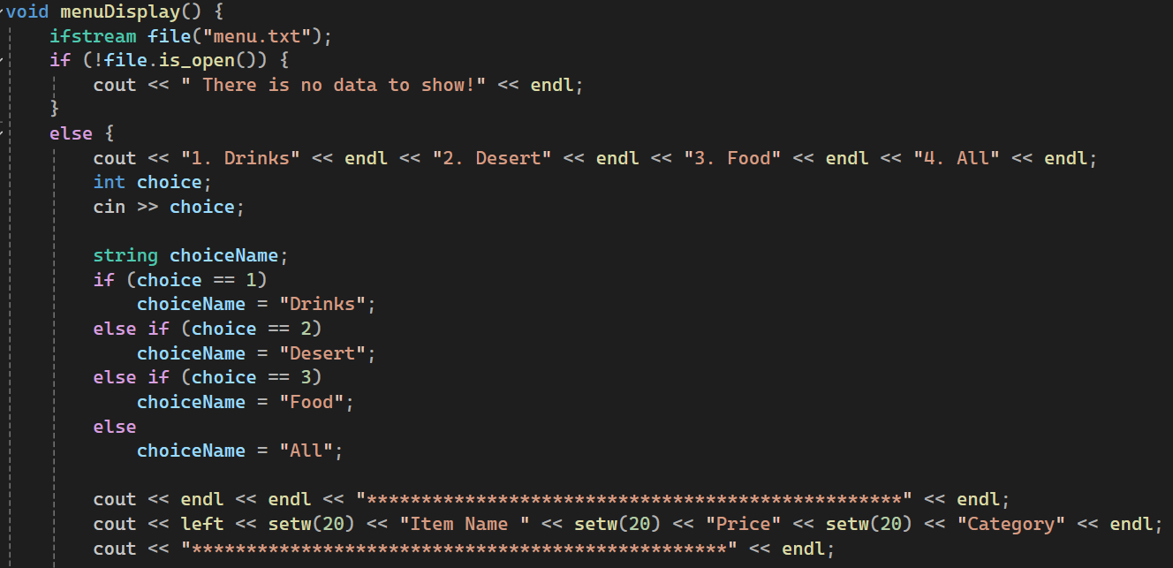
01 muneDisplay

Slide 12
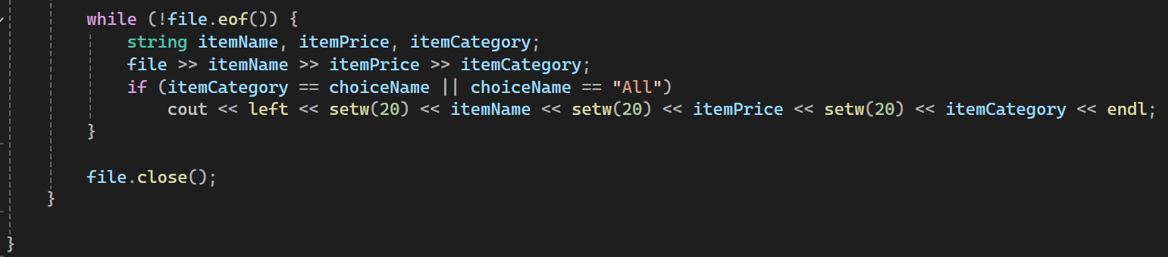
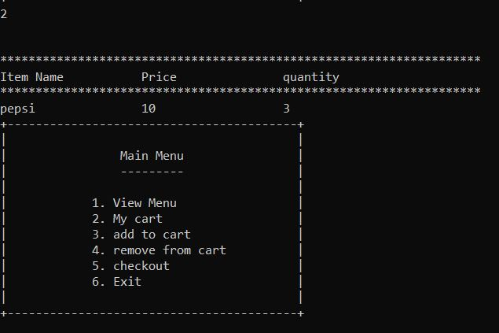
01 menueDisplay

Slide 13
02 addItem
Allows the user to add items to their cart from the menu.
Opening File: Opens the menu.txt file to read the menu items.
Checking File Status: If the file is not open, it displays a message "No data to show" and returns.
Displaying Menu with Item Numbers: Reads items from the file and displays them with item numbers for selection.
Adding Items to Cart:
01 Prompts the user to enter the item number and quantity to add.
02 reread the items from the file to find the selected item.
03 Creates an Item object and adds it to the cart array.
04 Increments numberOfItemsInCart.
05 Displays a success message if the item is found and added.
06 If the item number is not found, display an error message.
Continue Prompt: Ask the user if they want to continue adding items.

Slide 14
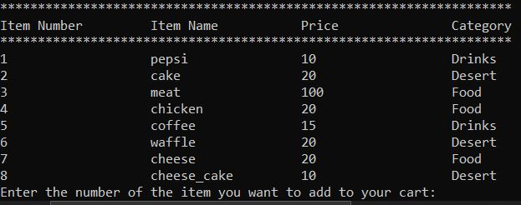
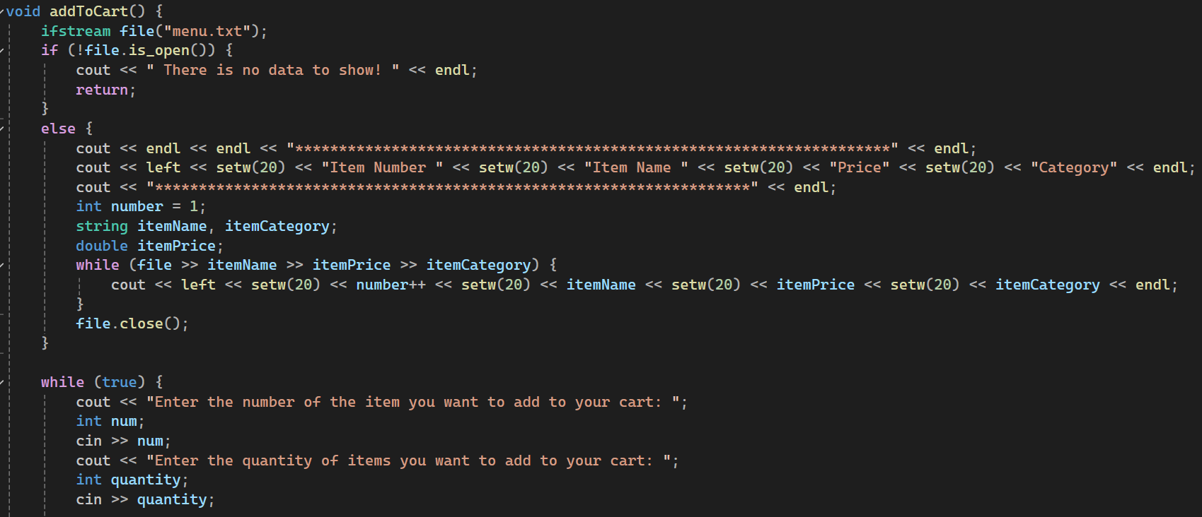
01 addItems

Slide 15
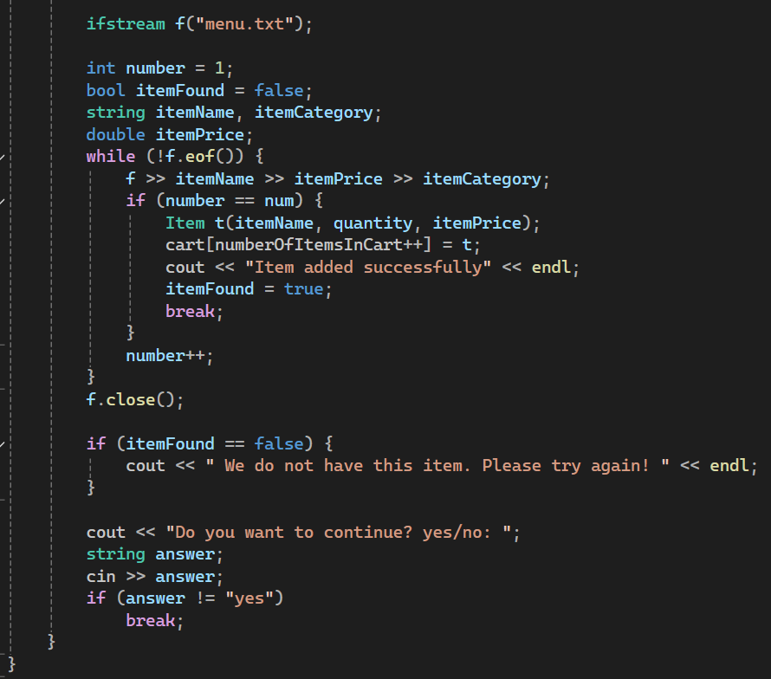
01 addItems

Slide 16
03 viewCarrt
It displays the current items in the cart.
Checking Cart Status: Checks if the cart is empty and displays a message if it is.
Displaying Cart Items: Lists all items in the cart with their name, price, and quantity using setw for formatting.

Slide 17
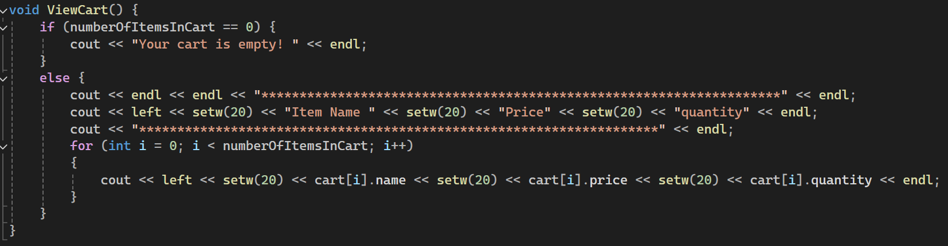
03 ViewCarrt

Slide 18
04 removeItem
Allows the user to remove items from the cart.
Checking Cart Status: Checks if the cart is empty and displays a message if it is.
Displaying Cart Items: Lists all items in the cart with their item numbers.
Removing Item:
01 Prompts the user to enter the item number to remove.
02 Validates the item number.
03 Removes the item by shifting subsequent items left in the array.
04 Decrements numberOfItemsInCart.
05 Displays a success message.
Displaying Updated Cart: Lists the updated cart items after removal.

Slide 19
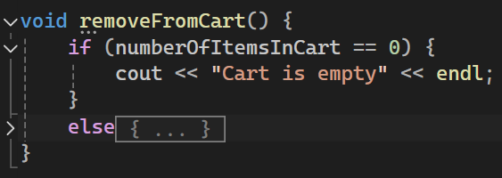
04 removeItem

Slide 20
05 Checkout
It calculates and displays the total cost of items in the cart, including delivery and tax.
Checking Cart Status: Checks if the cart is empty and displays a message if it is.
Displaying Cart Items: Lists all items in the cart with their item numbers, names, prices, and quantities.
Calculating Total:
01 Calculates the subtotal by summing the cost of each item (price * quantity).
02 Adds a fixed delivery charge (40$).
03 Calculates and adds tax (12% of the subtotal).
04 Displays the total amount due.

Slide 21
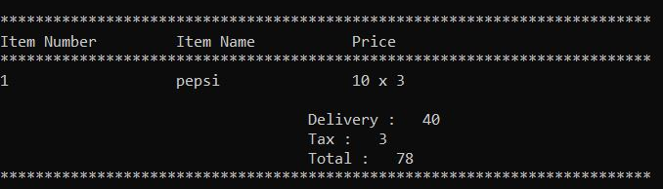
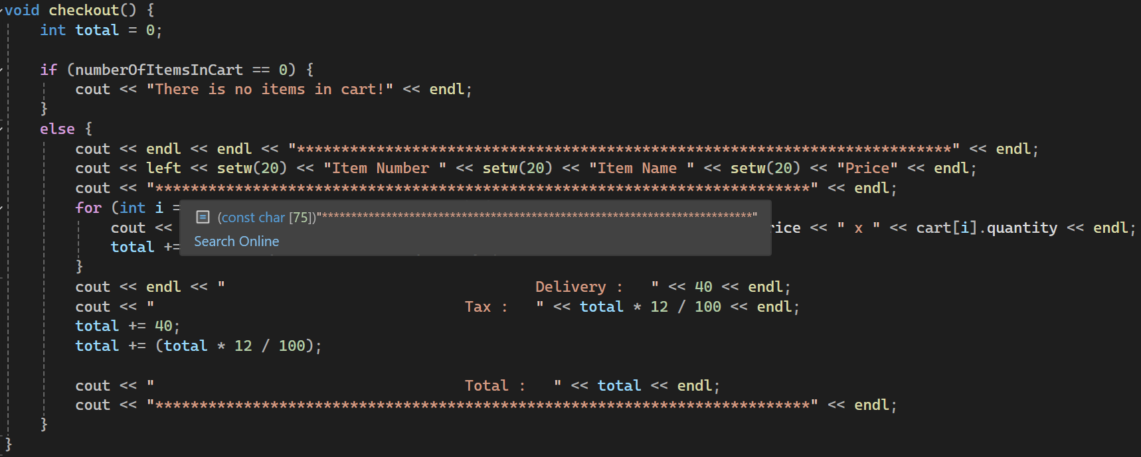
05 Checkout

Slide 22
06 exitProgram
Displays a thank you message and exits the program.
Displaying Message: Prints a thank you message.
Exiting Program: Calls exit(0) to terminate the program

Slide 23
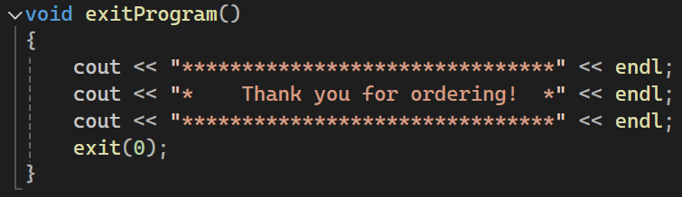
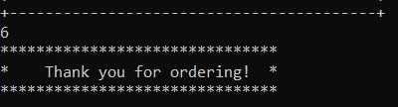
06 exitPtrogram

Slide 24
07 mainMenue
Displays the main menu and directs the user to the appropriate function based on their choice.
Displaying Menu: Prints the main menu with options.
Reading User Input: Reads the user’s choice.
Calling Functions: Calls the corresponding function based on the user’s choice using a switch statement.
Recursive Call: Recursively calls mainMenu to display the menu again after an action is completed.

Slide 25
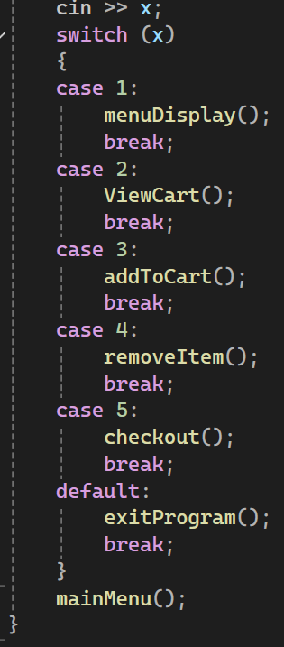
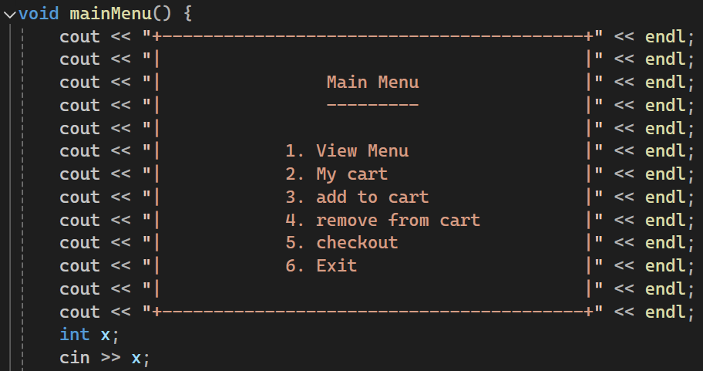
07 mainMenue

Slide 26
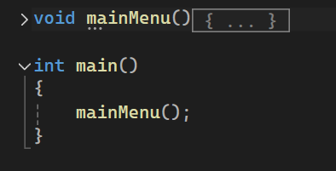
08 Main
Start the program by calling mainMenu.
Starting Point: The program’s entry point initiates the user interaction by displaying the main menu.

Slide 27
03 Conclusion
This program is a simple text-based shopping cart system that allows users to view a menu, add items to a cart, view the cart, remove items from the cart, and checkout. Each function is designed to handle a specific aspect of the shopping process, making the code modular and easy to understand. The use of file handling (ifstream), formatted output (setw), and basic control structures (if, while, for, switch) are fundamental to the program's operations.

Slide 28

Thanks!
Do you have any questions?
Made by:
Karim Wageh
Malak Mowaffak
Aly Mohamed
Malak Yasser

